Slide 1
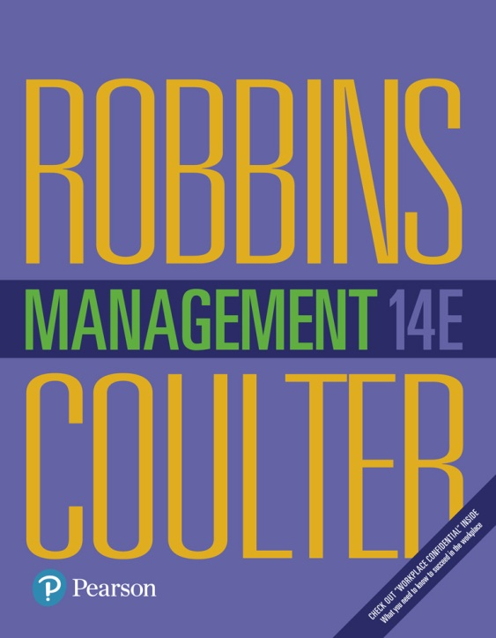
Management
Fourteenth Edition
Chapter 4
Managing in a Global Environment
Copyright © 2018, 2016, 2014 Pearson Education, Inc. All Rights Reserved

Slide 2
Learning Objectives
4.1 Contrast ethnocentric, polycentric, and geocentric attitudes toward global business.
Develop your skill at collaborating in cross-cultural settings.
4.2 Discuss the importance of regional trading alliances and global trade mechanisms.
4.3 Describe the structures and techniques organizations use as they go international.
4.4 Explain the relevance of the political/legal, economic, and cultural environments to global business.
Know how to be culturally aware.

Slide 3
What’s Your Global Perspective?
Parochialism: viewing the world solely through your own perspectives, leading to an inability to recognize differences between people
Notes:
Monolingualism is one sign that a nation suffers from parochialism—viewing the world solely through one’s own eyes and perspectives. People with a parochial attitude do not recognize that others have different ways of living and working. They ignore others’ values and customs and rigidly apply an attitude of “ours is better than theirs” to foreign cultures.
This type of narrow, restricted attitude is one approach that managers might take, but it isn’t the only one. In fact, there are three possible global attitudes. Let’s look at each more closely.
First, an ethnocentric attitude is the belief that the best work approaches and practices are those of the home country (the country in which the company’s parochialistic headquarters are located). Managers with an ethnocentric attitude believe that people in foreign countries don’t have the needed skills, expertise, knowledge, or experience to make the best business decisions as people in the home country do.

Slide 4
Three Possible Global Attitudes
Ethnocentric: view that home country has best work practices
Polycentric: view that managers in the host country know the best approaches
Geocentric: world-oriented view; wants to use best practices from around the globe
Notes:
First, an ethnocentric attitude is the belief that the best work approaches and practices are those of the home country (the country in which the company’s parochialistic headquarters are located). Managers with an ethnocentric attitude believe that people in foreign countries don’t have the needed skills, expertise, knowledge, or experience to make the best business decisions as people in the home country do.
A polycentric attitude is the view that employees in the host country (the foreign country in which the organization is doing business) know the best work approaches and practices for running their business. Managers with this attitude view every foreign operation as different and hard to understand. Thus, they’re likely to let employees there figure out how best to do things.
A geocentric attitude is a world-oriented view that focuses on using the best approaches and people from around the globe. Managers with this type of attitude have a global view and look for the best approaches and people regardless of origin.

Slide 5
Regional Trading Alliances
Global competition and the global economy are shaped by regional trading agreements, including:
European Union (EU)
North American Free Trade Agreement (NAFTA)
Association of Southeast Asian Nations (ASEAN)
BRICS
Notes:
Global competition and the global economy are shaped by regional trading agreements, including the European Union (EU), North American Free Trade Agreement (NAFTA), the Association of Southeast Asian Nations (ASEAN), and others.

Slide 6
The European Union
European Union (EU): a union of 28 democratic European nations created as a unified economic and trade entity with the Euro as a single common currency; 12 nations in 1992;
the primary motivation was to reassert the region’s economic position against the United States and Japan;
membership covers a population base of more than half a billion people (7 percent of the world population)24 and accounts for approximately 16 percent of the global trade.
Notes:
The European Union (EU) is an economic and political partnership of 28 democratic European countries. Eight countries (Croatia, the former Yugoslav Republic of Macedonia, Turkey, Albania, Bosnia-Herzegovina, Iceland, Montenegro, and Serbia) are candidates to join the EU.
When the 12 original members formed the EU in 1992, the primary motivation was to reassert the region’s economic position against the United States and Japan. Before then, each European nation had border controls, taxes, and subsidies; nationalistic policies; and protected industries. Now with these barriers removed, the economic power represented by the EU is considerable. Its current membership covers a population base of more than half a billion people (7 percent of the world population) and accounts for approximately 16 percent of the world’s global exports and imports.
Another step toward full unification occurred when the common European currency, the euro, was adopted. The euro is currently in use in 18 of the 28 member states, and all new member countries must adopt the euro. Only Denmark, the United Kingdom, and Sweden have been allowed to opt out of using the euro.

Slide 7
Brexit
In June 2016, the citizens of the United Kingdom (U.K.) voted to remove themselves from the EU because they felt that their needs and interests were being shifted to the greater EU.
Conflicts have arisen over immigration, legal, and economic policies. Conflicts have arisen over immigration, legal, and economic policies.
EURO
Another step toward full unification occurred when the common European currency, the euro, was adopted.
The euro is currently in use in 18 of the 28 member states, and all new member countries must adopt the euro.
The so-called Lisbon Treaty (or Reform Treaty), which was ratifed by all 28 member states, provides the EU with a common legal framework and the tools to meet the challenges of a changing world, including climatic and demographic changes, globalization, security, and energy

Slide 8
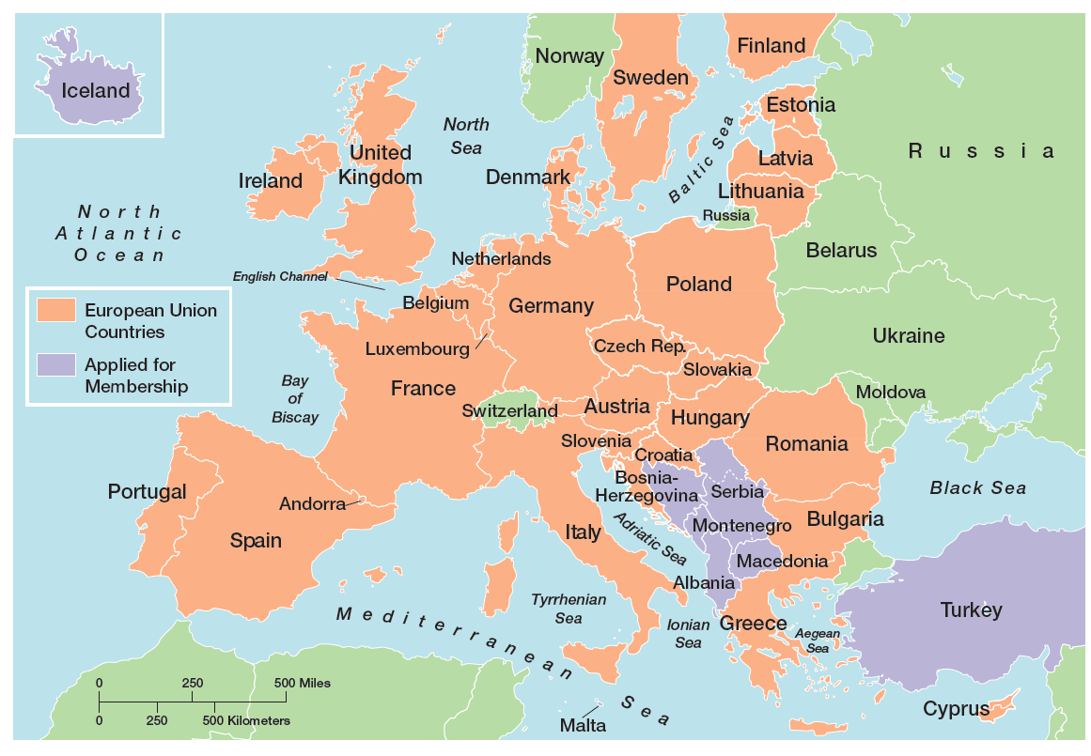
Exhibit 4-1 European Union Map
Exhibit 4-1 shows the members of the European Union.

Slide 9
North American Free Trade Agreement (NAFTA)
North American Free Trade Agreement (NAFTA): an agreement among the Mexican, Canadian, and U.S. governments in which barriers to trade have been eliminated. In 1992;
It’s the second largest trade alliance in the world in terms of combined gross domestic product (GDP) of its members.
U.S.–Central America Free Trade Agreement (CAFTA-DR),
promotes trade liberalization between the United States and ve Central American countries: Costa Rica, El Salvador, Guatemala, Honduras, and Nicaragua as well as the Dominican Republic
Notes:
When agreements in key issues covered by the North American Free Trade Agreement (NAFTA) were reached by the Mexican, Canadian, and U.S. governments in 1992, a vast economic agreement was created. It’s the second largest trade alliance in the world in terms of combined gross domestic product (GDP) of its members. Between 1994, when NAFTA went into effect, and 2014, imports from Canada and Mexico to the United States increased 212 percent and 637 percent, respectively. The rise in export activity from the United States to Canada and Mexico was 211 percent and 478 percent, respectively. Put into numbers, that translates to some $1.1 trillion ex- changed among NAFTA partners in 2014 alone.
Other Latin American nations have also become part of free trade agreements. Colombia, Mexico, and Venezuela led the way when all three signed an economic pact in 1994 eliminating import duties and tariffs. Another agreement, the U.S.–Central America Free Trade Agreement (CAFTA-DR), promotes trade liberalization between the United States and five Central American countries: Costa Rica, El Salvador, Guatemala, Honduras, and Nicaragua as well as the Dominican Republic.
Another free trade agreement of 10 South American countries known as the Southern Common Market or Mercosur already exists. Some South Americans see Mercosur as an effective way to combine resources to better compete against other global economic powers, especially the EU and NAFTA. With the future of FTAA highly doubtful, this regional alliance could take on new importance.

Slide 10
Association of Southeast Asian Nations (ASEAN)
Association of Southeast Asian Nations (ASEAN): a trading alliance of 10 Southeast Asian nations
The ASEAN region has a population of more than 625 million with a combined GDP of US $2.4 trillion.
“ASEAN’s biggest problem is that individual members haven’t been willing to sacrifice for the common good.”
Notes:
The Association of Southeast Asian Nations (ASEAN) is a trading alliance of 10 Southeast Asian nations (see Exhibit 4-2). The ASEAN region has a population of more than 625 million with a combined GDP of US $2.4 trillion.37 In addition to these 10 nations, leaders from a group dubbed ASEAN+3, which include China, Japan, and South Korea, have met to discuss trade issues. Also, leaders from India, Australia, and New Zealand have participated in trade talks with ASEAN+3 as well.
The main issue with creating a trade agreement of all 16 nations has been the lack of any push toward regional integration. Despite the Asian culture’s emphasis on consensus building, “ASEAN’s biggest problem is that individual members haven’t been willing to sacrifice for the common good.”

Slide 11
Exhibit 4-2 ASEAN Map
Exhibit 4-2 shows the members of ASEAN.
Notes:
Source: International Bar Association, “Southeast Asia Is Aiming High As It Plans for Closer Economic and Trade Integration. Law, and Lawyers, Have a Big Part to Play,” www.ibanet.org, accessed January 24, 2016.

Slide 12
Other Trade Alliances
African Union (AU)
For instance, the 54-nation African Union (AU), which came into existence in 2002, seeks to “build an integrated, prosperous and peaceful Africa, an Africa driven and managed by its own citizens and representing a dynamic force in the international arena.”
East African Community (EAC)
Five east African nations—Burundi, Kenya, Rwanda, Tanzania, and Uganda—have formed a common market called the East African Community (EAC).
Notes:
Other regions around the world have also developed regional trading alliances. For instance, the 54-nation African Union (AU), which came into existence in 2002, seeks to “build an integrated, prosperous and peaceful Africa, an Africa driven and managed by its own citizens and representing a dynamic force in the international arena.”
Five east African nations—Burundi, Kenya, Rwanda, Tanzania, and Uganda— have formed a common market called the East African Community (EAC).
The South Asian Association for Regional Cooperation (SAARC), composed of eight member states (India, Pakistan, Sri Lanka, Bangladesh, Bhutan, Nepal, the Maldives, and Afghanistan), began eliminating tariffs in 2006.
Finally, in 2015, 12 countries forged the terms of a trade alliance called the Trans-Pacific Partnership (TPP). The countries involved in the agreement include the United States, Canada, Mexico, Japan, Australia, and seven other countries around the Pacific region, excluding China (see Exhibit 4-3).

Slide 13
South Asian Association for Regional Cooperation (SAARC)
composed of eight member states (India, Pakistan, Sri Lanka, Bangladesh, Bhutan, Nepal, the Maldives, and Afghanistan), began eliminating tariffs in 2006.
Trans-Pacific Partnership (TPP)
in 2015, 12 countries forged the terms of a trade alliance called the Trans-Pacic Partnership (TPP). The countries involved in the agreement include the United States, Canada, Mexico, Japan, Australia, and seven other countries around the Pacic region, excluding China.
it will influence about two-thirds of world economic input

Slide 14
Exhibit 4-3 TPP Map
Exhibit 4-3 shows the current members of TPP and countries indicating a desire to join.
Notes:
If the agreement goes into effect, it will influence about two-thirds of world economic input, making it among the largest trade alliances of all time. Among its provisions is the elimination of more than 18,000 tariffs that make cross-national trade relationships costly.

Slide 15
Global trade Mechanism
Global trade among nations doesn’t just happen on its own. As trade issues arise, global trade systems ensure that trade continues efficiently and effectively. Indeed, one of the realities of globalization is the interdependence of countries—that is, what happens in one can impact others, good or bad.
Four important global trade mechanisms:
Notes:
The World Trade Organization (WTO) is a global organization of 161 countries (as of April 2015) that deals with the rules of trade among nations.48 Formed in 1995, the WTO evolved from the General Agreement on Tariffs and Trade (GATT), a trade agreement in effect since the end of World War II. To- day, the WTO is the only global organization that deals with trade rules among nations. Its membership consists of 161 member countries and 24 observer governments (which have a specific time frame within which they must apply to become members).
The goal of the WTO is to help countries conduct trade through a system of rules. Although critics have staged vocal protests against the WTO, claiming that global trade destroys jobs and the natural environment, it appears to play an important role in monitoring, promoting, and protecting global trade.

Slide 16
Global Trade Mechanisms
World Trade Organization (WTO)
International Monetary Fund (IMF)
World Bank Group
Organization for Economic Cooperation and Development (OECD)
Notes:
Global trade among nations doesn’t just happen on its own. As trade issues arise, global trade systems ensure that trade continues efficiently and effectively. Indeed, one of the realities of globalization is the interdependence of countries—that is, what happens in one can impact others, good or bad.
We’re going to look at four important global trade mechanisms: the World Trade Organization, the International Monetary Fund, the World Bank Group, and the Organization for Economic Cooperation and Development.

Slide 17
World Trade Organization
World Trade Organization (WTO): global organization of 161 countries that deals with the rules of trade among nations
Formed in 1995, the WTO evolved from the General Agreement on Tariffs and Trade (GATT), a trade agreement in effect since the end of World War II.
The goal of the WTO is to help countries conduct trade through a system of rules;
critics, claiming that global trade destroys jobs and the natural environment, it appears to play an important role in monitoring, promoting, and protecting global trade.
For instance, the WTO ruled that the European plane maker Airbus received improper European Union subsidies for the A380 super jumbo jet and several other airplanes, hurting its American rival, Boeing.49 Airbus has the right to appeal the ruling, but even after appealing, any member ultimately found to have provided improper subsidies is obliged to bring its policies into compliance with global trade rules. Failure to comply could bring trade sanctions.
Case of rare earth minerals of china, used for production in smart phone, wind turbines, hybrid car batteries.

Slide 18
International Monetary Fund and World Bank Group
International Monetary Fund (IMF): An organization of 188 countries that promotes international monetary cooperation and provides advice, loans, and technical assistance
World Bank Group: a group of very closely associated institutions that provides financial and technical assistance to developing countries.
The goal of the World Bank Group is to promote long-term economic development and poverty reduction by providing members with technical and financial support
Notes:
Two other important and necessary global trade mechanisms include the International Monetary Fund and the World Bank Group. The International Monetary Fund (IMF) is an organization of 188 countries that promotes international monetary cooperation and provides member countries with policy advice, temporary loans, and technical assistance to establish and maintain financial stability and to strengthen economies. During the global financial turmoil of the last few years, the IMF was on the forefront of advising countries and governments in getting through the difficulties.
The World Bank Group is a group of five closely associated institutions, all owned by its member countries, that provides vital financial and technical assistance to developing countries around the world. The goal of the World Bank Group is to promote long-term economic development and poverty reduction by providing members with technical and financial support.

Slide 19
Organization for Economic Cooperation and Development
Organization for Economic Cooperation and Development (OECD): an international economic organization that helps its 34 member countries achieve sustainable economic growth and employment
Notes:
The forerunner of the OECD, the Organization for European Economic Cooperation, was formed in 1947 to administer American and Canadian aid under the Marshall Plan for the reconstruction of Europe after World War II. Today, the Organization for Economic Cooperation and Development (OECD) is a Paris-based international economic organization whose mission is to help its 34 member countries achieve sustainable economic growth and employment and raise the standard of living in member countries while maintaining financial stability in order to contribute to the development of the world economy.
With a long history of facilitating economic growth around the globe, the OECD now shares its expertise and accumulated experiences with more than 80 developing and emerging market economies.

Slide 20
How Organizations Go International (1 of 2)
Global sourcing: purchasing materials or labor from around the world wherever it is cheapest
Notes:
When organizations do go international, they often use different approaches. (see Exhibit 4-4). Managers who want to get into a global market with minimal investment may start with global sourcing (also called global outsourcing), which is purchasing materials or labor from around the world wherever it is cheapest. The goal takes advantage of lower costs in order to be more competitive.
Although global sourcing may be the first step in going international for many companies, they often continue to use this approach because of the competitive advantages it offers. Each successive stage of going international beyond global sourcing, however, requires more investment and thus entails more risk for the organization.

Slide 21
How Organizations Go International (2 of 2)
Multinational corporation (MNC)
Multidomestic corporation (IMF)
Global company
Transnational or borderless organization
Notes:
Today, few companies don’t do business internationally. However, there’s not a generally accepted approach to describe the different types of international companies; different authors call them different things. The book authors use the terms multinational, multidomestic, global, and transnational.
A multinational corporation (MNC) is any type of international company that maintains operations in multiple countries. One type of MNC is a multidomestic corporation, which decentralizes management and other decisions to the local country. This type of globalization reflects the polycentric attitude. A multi-domestic corporation doesn’t attempt to replicate its domestic successes by managing foreign operations from its home country. Instead, local employees typically are hired to manage the business, and marketing strategies are tailored to that country’s unique characteristics.
Another type of MNC is a global company, which centralizes its management and other decisions in the home country. This approach to globalization reflects the ethnocentric attitude. Global companies treat the world market as an integrated whole and focus on the need for global efficiency and cost savings. Although these companies may have considerable global holdings, management decisions with company-wide implications are made from the headquarters in the home country.
Other companies use an arrangement that eliminates artificial geographical barriers. This type of MNC is often called a transnational, or borderless, organization and reflects a geocentric attitude. For example, IBM dropped its organizational structure based on country and reorganized into industry groups. Ford Motor Company is pursuing what it calls the One Ford concept as it integrates its operations around the world.

Slide 22
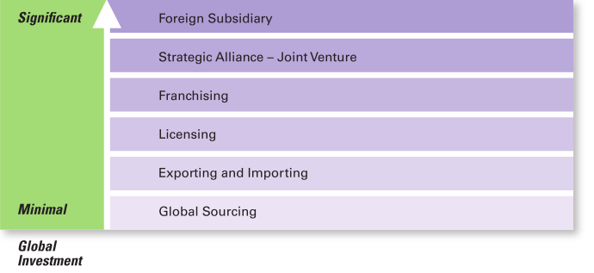
Exhibit 4-4 How Organizations Go Global
Exhibit 4-4 shows the different approaches companies can use to go global.

Slide 23
Going Global: Exporting and Importing
Exporting: making products domestically and selling them abroad
Importing: acquiring products made abroad and selling them domestically
Notes:
The next step in going international may involve exporting the organization’s products to other countries—that is, making products domestically and selling them abroad.
In addition, an organization might do importing, which involves acquiring products made abroad and selling them domestically. Both usually entail minimal investment and risk, which is why many small businesses often use these approaches to doing business globally.

Slide 24
Going Global: Licensing and Franchising
Licensing: an organization gives another organization the right to make or sell its products using its technology or product specifications
Franchising: an organization gives another organization the right to use its name and operating methods
Notes:
Managers also might use licensing or franchising, which are similar approaches involving one organization giving another organization the right to use its brand name, technology, or product specifications in return for a lump sum payment or a fee usually based on sales.
The only difference is that licensing is primarily used by manufacturing organizations that make or sell another company’s products and franchising is primarily used by service organizations that want to use another company’s name and operating methods.

Slide 25
Going Global: Strategic Alliances and Joint Ventures
Strategic Alliance: partnership between an organization and foreign company partner(s) in which both share resources and knowledge in developing new products or building production facilities
Joint Venture: A specific type of strategic alliance in which the partners agree to form a separate, independent organization for some business purpose
Notes:
When an organization has been doing business internationally for a while and has gained experience in international markets, managers may decide to make more of a direct foreign investment. One way to increase investment is through a strategic alliance, which is a partnership between an organization and a foreign company partner or partners in which both share resources and knowledge in developing new products or building production facilities. For example, Honda Motor and General Electric teamed up to produce a new jet engine.
A specific type of strategic alliance in which the partners form a separate, independent organization for some business purpose is called a joint venture. For example, Hewlett-Packard has had numerous joint ventures with various suppliers around the globe to develop different components for its computer equipment. British automaker Land Rover and Chinese automaker Chery created a joint venture, which aims to combine the experience of Britain’s luxury vehicle manufacturer with Chery’s deep understanding of the Chinese markets and customer preferences. These partnerships provide a relatively easy way for companies to compete globally.

Slide 26
Going Global: Foreign Subsidiary
Foreign Subsidiary: directly investing in a foreign country by setting up a separate and independent production facility or office
Notes:
Finally, managers may choose to directly invest in a foreign country by setting up a foreign subsidiary as a separate and independent facility or office. This subsidiary can be managed as a multidomestic organization (local control) or as a global organization (centralized control). As you can probably guess, this arrangement involves the greatest commitment of resources and poses the greatest amount of risk.

Slide 27
Managing in a Global Environment
What challenges will a manager face in a new country?
Notes:
Assume for a moment that you’re a manager going to work for a branch of a global organization in a foreign country. You know that your environment will differ from the one at home, but how? What should you look for?
Although our discussion is presented through the eyes of a U.S. manager, this framework could be used by any manager, regardless of national origin, who manages in a foreign environment.

Slide 28
Political/Legal Environment
U.S. managers are accustomed to a stable legal and political system
Managers must stay informed of the specific laws in countries where they do business
Some countries have risky political climates
Notes:
U.S. managers are accustomed to a stable legal and political system. Changes tend to be slow, and legal and political procedures are well established. Elections are held at regular intervals, and even when the political party in power changes after an election, it’s unlikely that anything too radical will happen. The stability of laws allows for accurate predictions. However, this certainly isn’t true for all countries.
Managers must stay informed of the specific laws in countries where they do business. For instance, the president of Zimbabwe is pushing ahead with plans to force foreign companies to sell majority stakes to locals.
Also, some countries have risky political climates. For instance, BP could have warned Exxon about the challenges of doing business in Russia. During its long involvement in the country, BP has “had so many police run-ins that its stock price often nudges up or down in response to raids or the arrests of employees.”
Keep in mind that a country’s political/legal environment doesn’t have to be risky or unstable to be a concern to managers. Just the fact that it differs from that of the home country is important. Managers must recognize these differences if they hope to understand the constraints and opportunities that exist.

Slide 29
Economic Environment
Free Market Economy: an economic system in which resources are primarily owned and controlled by the private sector
Planned Economy: an economic system in which economic decisions are planned by a central government
Notes:
A global manager must be aware of economic issues when doing business in other countries. First, it’s important to understand a country’s type of economic system. The two major types are a free market economy and a planned economy. A free market economy is one in which resources are primarily owned and controlled by the private sector.
A planned economy is one in which economic decisions are planned by a central government. Actually, no economy is purely a free market or planned. For instance, the United States and United Kingdom are toward the free market end of the spectrum but do have governmental intervention and controls. The economies of Vietnam and North Korea are more planned. China is also a more planned economy, but until recently had been moving toward being a more free market economy.
Other economic issues managers need to understand include (1) currency exchange rates, (2) inflation rates, and (3) diverse tax policies.

Slide 30
Cultural Environment
National Culture—the values and attitudes shared by individuals from a specific country that shape their behavior and beliefs about what is important.
Notes:
As we know from Chapter 3, organizations have different cultures. Countries have cultures, too. National culture includes the values and attitudes shared by individuals from a specific country that shape their behavior and their beliefs about what is important. Legal, political, and economic differences among countries are fairly obvious. Getting information about cultural differences isn’t quite that easy! The primary reason? It’s difficult for natives to explain their country’s unique cultural characteristics to someone else.

Slide 31
Exhibit 4-5 What Are Americans Like?
Characteristic
Americans are very informal. They tend to treat people alike even when great differences in age or social standing are evident.
Americans are direct. They don’t talk around things. To some foreigners, this may appear as abrupt or even rude behavior.
American are competitive. Some foreigners may find Americans assertive or overbearing.
Americans are achievers. They like to keep score, whether at work or at play. They emphasize accomplishments.
Americans are independent and individualistic. They place a high value on freedom and believe that individuals can shape and control their own destiny.
Americans are questioners. They ask a lot of questions, even of someone they have just met. Many may seem pointless (“How ya’ doin’?) or personal (What kind of work do you do?”)
Americans dislike silence. They would rather talk about the weather than deal with silence in a conversation.
Americans value punctuality. They keep appointment calendars and live according to schedules and clocks.
Americans value cleanliness. They often seem obsessed with bathing, eliminating body odors, and wearing clean clothes.
Notes:
Legal, political, and economic differences among countries are fairly obvious. The Japanese manager who works in the United States or his or her American counterpart who works in Japan can get information about laws or tax policies without too much e ort. Getting information about cultural differences isn’t quite that easy! The primary reason? It’s difficult for natives to explain their country’s unique cultural characteristics to someone else. For instance, if you were born and raised in the United States, how would you describe U.S. culture? In other words, what are Americans like?
Think about it for a moment and see which characteristics in Exhibit 4-5 you identified.
Sources: Based on M. Ernest, ed., Predeparture Orientation Handbook: For Foreign Students and Scholars Planning to Study in the United States (Washington, DC: U.S. Information Agency, Bureau of Cultural Affairs, 1984), pp. 103–105; A. Bennett, “American Culture Is Often a Puzzle for Foreign Managers in the U.S.,” Wall Street Journal, February 12, 1986, p. 29; “Don’t Think Our Way’s the Only Way,” The Pryor Report, February 1988, p. 9; and B. J. Wattenberg, “The Attitudes Behind American Exceptionalism,” U.S. News & World Report, August 7, 1989, p. 25.

Slide 32
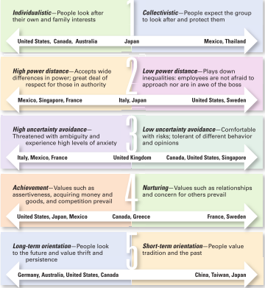
Exhibit 4-6 Hofstede’s Five Dimensions of National Culture
Exhibit 4-6 shows Hofstede’s Five Dimensions of National Culture.
Notes:
Geert Hofstede developed one of the most widely referenced approaches to helping managers better understand differences between national cultures. His research found that countries vary on five dimensions of national culture. These dimensions are described in Exhibit 4-6, which also shows some of the countries characterized by those dimensions.
Source: Based on Hofstede, Geert, Culture’s Consequences: International Differences in Work-Related Values, © Geert Hofstede, 1980 (Newbury Park: SAGE Publications, Inc., 1980).

Slide 33
Global Leadership and Organizational Behavior Effectiveness (GLOBE)
Power distance
Uncertainty avoidance
Assertiveness
Humane orientation
Future orientation
Institutional collectivism
Gender differentiation
In-group collectivism
Performance orientation
Notes:
The Global Leadership and Organizational Behavior Effectiveness (GLOBE) program is an ongoing research program that extended Hofstede’s work by investigating cross-cultural leadership behaviors and giving managers additional information to help them identify and manage cultural differences. Using data from more than 18,000 managers in 62 countries, the GLOBE research team (led by Robert House) identified 9 dimensions on which national cultures differ.
Two dimensions (power distance and uncertainty avoidance) fit directly with Hofstede’s. Four are similar to Hofstede’s (assertiveness, which is similar to achievement-nurturing; humane orientation, which is similar to the nurturing dimension; future orientation, which is similar to long-term and short-term orientation; and institutional collectivism, which is similar to individualism-collectivism). The remaining three (gender differentiation, in-group collectivism, and performance orientation) offer additional insights into a country’s culture.
The GLOBE studies confirm that Hofstede’s dimensions are still valid and extend his research rather than replace it. GLOBE’s added dimensions provide an expanded and updated measure of countries’ cultural differences. It’s likely that cross-cultural studies of human behavior and organizational practices will increasingly use the GLOBE dimensions to assess differences between countries.

Slide 34
Global Management in Today’s World (1 of 2)
The Challenge of Openness
Increased threat of terrorism
Economic interdependence of trading countries
Intense fundamental cultural differences
Notes:
Globalization also creates challenges because of the openness that’s necessary for it to work. One challenge is the increased threat of terrorism by a truly global terror network. Globalization is meant to open up trade and to break down the geographical barriers separating countries. Yet, opening up means just that—being open to the bad as well as the good.
Another challenge from openness is the economic interdependence of trading countries. As we saw over the last couple of years, the faltering of one country’s economy can have a domino effect on other countries with which it does business. So far, however, the world economy has proved to be quite resilient.
The far more serious challenge for managers in the openness required by globalization comes from intense underlying and fundamental cultural differences—differences that encompass traditions, history, religious beliefs, and deep-seated values. Managing in such an environment can be extremely complicated.

Slide 35
Global Management in Today’s World (2 of 2)
Cultural Intelligence: cultural awareness and sensitivity skills
Global Mind-Set: attributes that allow a leader to be effective in cross-cultural environments
Notes:
As globalization continues to be important for businesses, it’s obvious that managers need to understand how to best manage that global workforce. Some researchers have suggested that managers need cultural intelligence or cultural awareness and sensitivity skills. Cultural intelligence encompasses three main dimensions: (1) knowledge of culture as a concept—how cultures vary and how they affect behavior; (2) mindfulness—the ability to pay attention to signals and reactions in different cross-cultural situations; and (3) behavioral skills—using one’s knowledge and mindfulness to choose appropriate behaviors in those situations.
Other researchers have said that what effective global leaders need is a global mind-set, attributes that allow a leader to be effective in cross-cultural environments.
Those attributes have three components as shown in Exhibit 4-7.

Slide 36
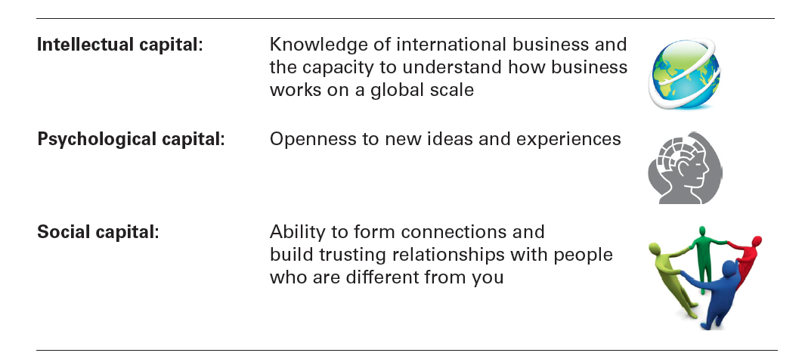
Exhibit 4-7 A Global Mind-Set
Intellectual capital: | Knowledge of international business and the capacity to understand how business works on a global scale
Psychological capital: | Openness to new ideas and experiences
Social capital: | Ability to form connections and build trusting relationships with people who are different from you
Exhibit 4-7 shows components of a global mind-set.
Notes:
Source: Based on M. Javidan, M.Teagarden, and D. Bowen, “Making It Overseas,” Harvard Business Review, April 2010, and J. McGregor, ed., “Testing Managers’ Global IQ,” Bloomberg BusinessWeek, September 28, 2009.

Slide 37
Review Learning Objective 4.1
Contrast ethnocentric, polycentric, and geocentric attitudes toward global business.
Parochialism—viewing the world solely through your own eyes and perspectives.
Polycentric attitude—managers in the host country know the best work approaches and practices for running their business.
Geocentric attitude—a world-oriented view that focuses on using the best approaches and people from around the globe.
Notes:
Parochialism is viewing the world solely through your own eyes and perspectives and not recognizing that others have different ways of living and working. An ethnocentric attitude is the parochial belief that the best work approaches and practices are those of the home country. A polycentric attitude is the view that the managers in the host country know the best work approaches and practices for running their business. A geocentric attitude is a world-oriented view that focuses on using the best approaches and people from around the globe.

Slide 38
Review Learning Objective 4.2 (1 of 2)
Discuss the importance of regional trading alliances and global trade mechanisms.
The European Union consists of 28 democratic countries.
NAFTA helps Canada, Mexico, and the United States strengthen their global economic power.
ASEAN is a trading alliance of 10 Southeast Asian nations.
Other trade alliances
World Trade Organization (WTO) monitors and promotes trade relationships.
Notes:
Countries enter regional trading alliances for a variety of reasons, mainly to stimulate economic growth. The European Union consists of 28 democratic countries with 5 countries having applied for membership. NAFTA continues to help Canada, Mexico, and the United States strengthen their global economic power. In Latin America, CAFTA-DR promotes trade liberalization between the United States and 5 Central American countries, and another free trade agreement of 10 South American countries known as the Southern Common Market or Mercosur is seen as an effective way to combine resources to better compete against other global economic powers. ASEAN is a trading alliance of 10 Southeast Asian nations—a region that remains important in the global economy.
Other trade alliances include the African Union (AU), the East African Community (EAC), the South Asian Association for Regional Cooperation (SAARC), and the Trans-Pacific Partnership (TPP).

Slide 39
Review Learning Objective 4.2 (2 of 2)
The International Monetary Fund (IMF) and the World Bank Group provide monetary support.
The Organization for Economic Cooperation and Development assists its member countries with financial support.
Notes:
To counteract some of the risks in global trade, the World Trade Organization (WTO) plays an important role in monitoring and promoting trade relationships. The International Monetary Fund (IMF) and the World Bank Group are two entities that provide monetary support and advice to their member countries. The Organization for Economic Cooperation and Development assists its member countries with financial support in achieving sustainable economic growth and employment.

Slide 40
Review Learning Objective 4.3 (1 of 3)
Describe the structures and techniques organizations use as they go international.
A multinational corporation—an international company that maintains operations in multiple countries.
A multidomestic organization—an MNC that decentralizes management and other decisions to the local country.
A global organization—an MNC that centralizes management and other decisions in the home country.
A transnational organization—an MNC that has eliminated artificial geographical barriers.
Notes:
A multinational corporation is an international company that maintains operations in multiple countries. A multidomestic organization is an MNC that decentralizes management and other decisions to the local country (the polycentric attitude). A global organization is an MNC that centralizes management and other decisions in the home country (the ethnocentric attitude). A transnational organization (the geocentric attitude) is an MNC that has eliminated artificial geographical barriers and uses the best work practices and approaches from wherever.

Slide 41
Review Learning Objective 4.3 (2 of 3)
Global sourcing: purchasing materials or labor from around the world wherever it is cheapest.
Exporting: making products domestically and selling them abroad.
Importing: acquiring products made abroad and selling them domestically.
Licensing: gives that organization the right to use the company’s brand name, technology, or product specifications.
Franchising: use another company’s name and operating methods.
Notes:
Global sourcing is purchasing materials or labor from around the world wherever it is cheapest. Exporting is making products domestically and selling them abroad. Importing is acquiring products made abroad and selling them domestically.
Licensing is used by manufacturing organizations that make or sell another company’s products and gives that organization the right to use the company’s brand name, technology, or product specifications. Franchising is similar but is usually used by service organizations that want to use another company’s name and operating methods.

Slide 42
Review Learning Objective 4.3 (3 of 3)
Global strategic alliance: partnership between an organization and foreign company partners
Joint venture: a strategic alliance in which the partners agree to form a separate, independent organization for some business purpose
Foreign subsidiary: direct investment in a foreign country that a company creates by establishing a separate and independent facility or office
Notes:
A joint venture is a specific type of strategic alliance in which the partners agree to form a separate, independent organization for some business purpose. A foreign subsidiary is a direct investment in a foreign country that a company creates by establishing a separate and independent facility or office.

Slide 43
Review Learning Objective 4.4 (1 of 2)
Explain the relevance of the political/legal, economic, and cultural environments to global business.
The laws and political stability of a country are issues in the global political/legal environment with which managers must be familiar
Managers must be aware of a country’s economic issues such as currency exchange rates, inflation rates, and tax policies.
Notes:
The laws and political stability of a country are issues in the global political/legal environment with which managers must be familiar. Likewise, managers must be aware of a country’s economic issues such as currency exchange rates, inflation rates, and tax policies.

Slide 44
Review Learning Objective 4.4 (2 of 2)
Geert Hofstede identified five dimensions for assessing a country’s culture: individualism-collectivism, power distance, uncertainty avoidance, achievement-nurturing, and long-term/short-term orientation.
The GLOBE studies identified nine dimensions for assessing country cultures.
Notes:
Geert Hofstede identified five dimensions for assessing a country’s culture, including individualism-collectivism, power distance, uncertainty avoidance,
achievement-nurturing, and long-term/short-term orientation. The GLOBE studies identified nine dimensions for assessing country cultures: power distance, uncertainty avoidance, assertiveness, humane orientation, future orientation, institutional collectivism, gender differentiation, in-group collectivism, and performance orientation.

Slide 45
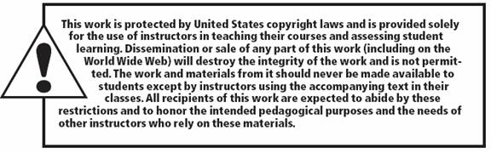
Copyright

